Slide 1
API for Google Forms Data

Slide 2
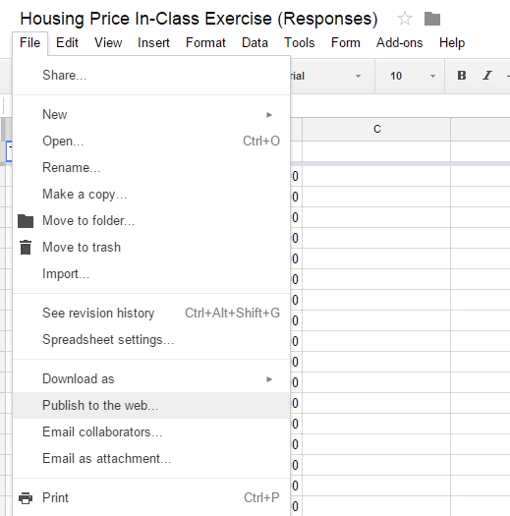

Slide 3
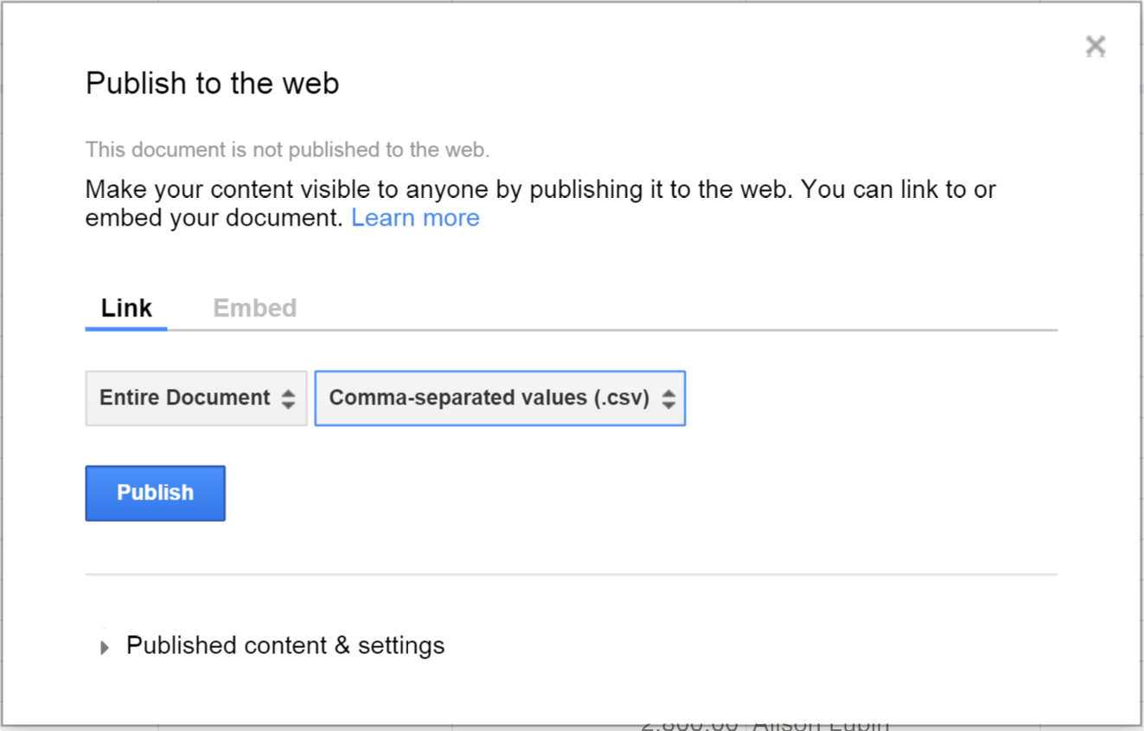
Select the CSV format.

Slide 4
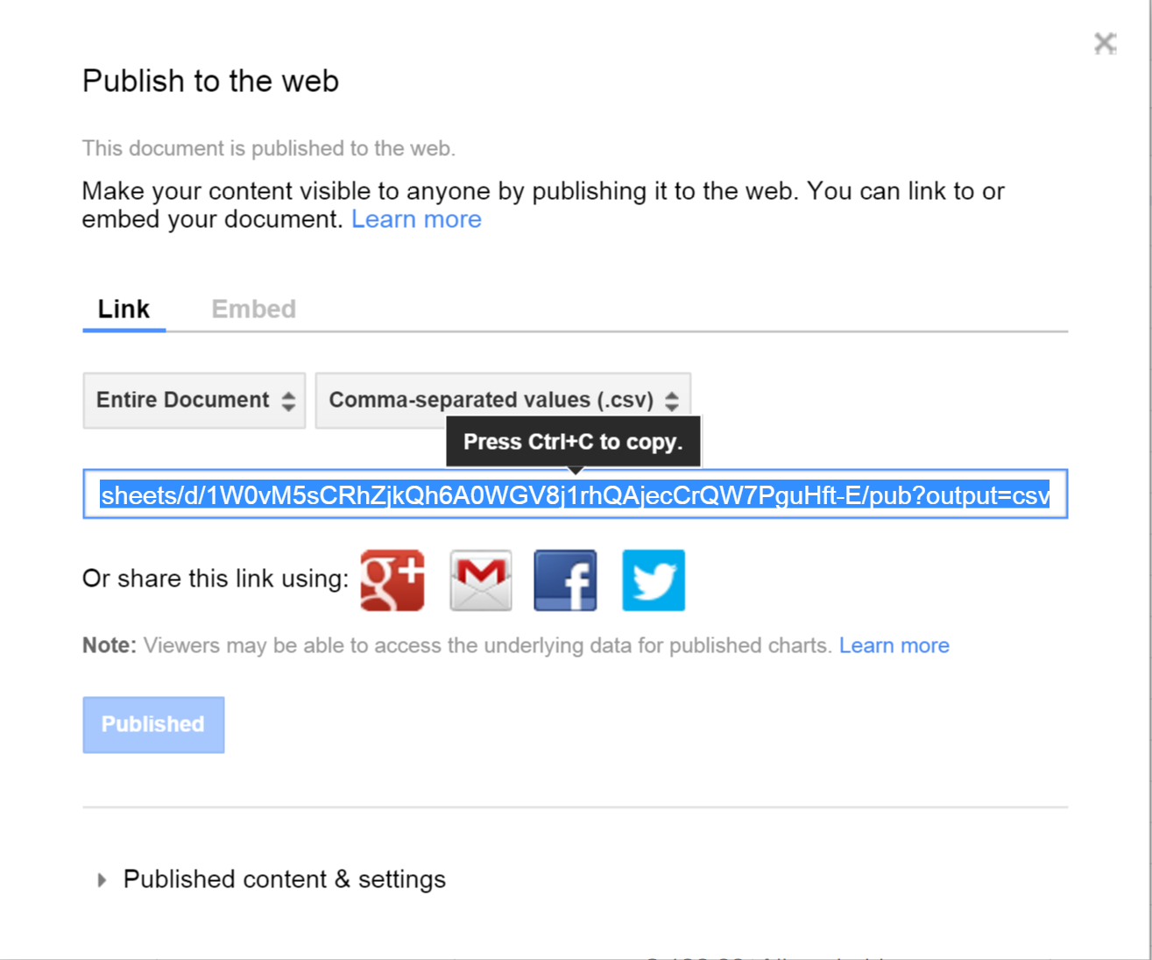
Copy the link to download the data.

Slide 5
Read in via RCurl
require( RCurl )
my.url <- "https://docs.google.com/spreadsheets/d/1W0vM5sCRhZjkQh6A0WGV8j1rhQAjecCrQW7PguHft-E/pub?gid=1989082857&single=true&output=csv"
housing.raw <- getURL( my.url, ssl.verifypeer=FALSE )
dat.housing <- read.csv( textConnection(housing.raw) )

Slide 6
Download as CSV
### create a new directory for your data
dir.create( "data" )
setwd( "./data" )
### download csv version of data
download.file( "https://docs.google.com/spreadsheets/d/1W0vM5sCRhZjkQh6A0WGV8j1rhQAjecCrQW7PguHft-E/pub?gid=1989082857&single=true&output=csv", "housing dat.csv" )
dat <- read.csv( "housing dat.csv" )

Slide 7
From GitHub:

Slide 8
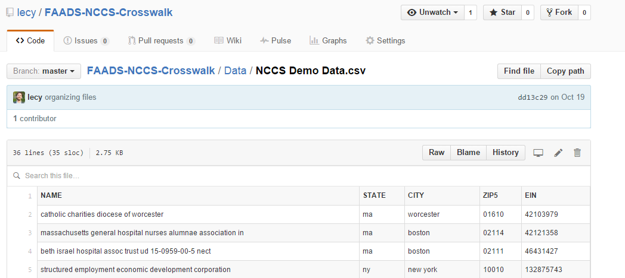
Find the data you want to load, and click on the “Raw” view.

Slide 9
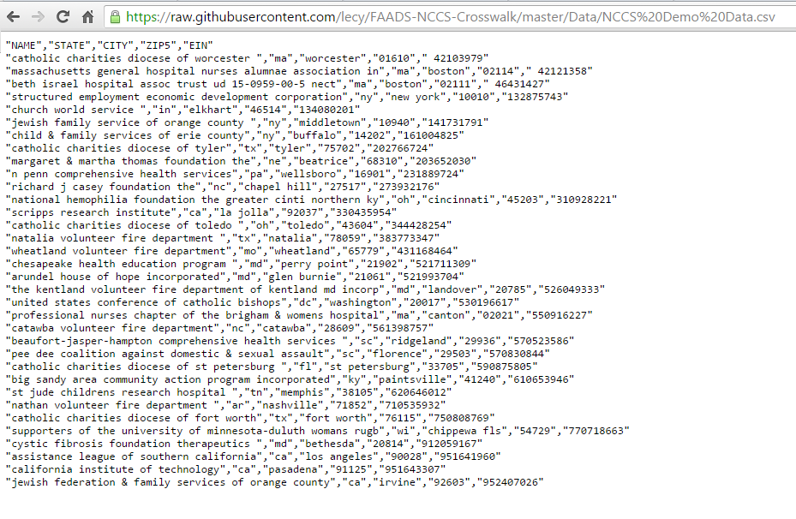
Copy the URL

Slide 10
# Load required packages
library( RCurl )
# Create an object for the URL where your data is stored.
url.faads <- "https://raw.githubusercontent.com/lecy/FAADS-NCCS-Crosswalk/master/Data/FAADS%20Demo%20Data.csv"
# Use getURL from RCurl to download the file.
faads.sample <- getURL( url.faads, ssl.verifypeer = FALSE )
# Finally let R know that the file is in .csv format so that it can create a data frame.
faads.sample <- read.csv(textConnection( faads.sample ), stringsAsFactors=FALSE )

